Slide 1




Parul Polytechnic Institute
Computer Engineering

Slide 2

A Major Project Presentation On
Roommate AI – Smart room automation.
Guided By:
Prof. Poonam Faldu
Presented By:
Chavda Adityasinh – 2303466160070
Meet Agrawal – 2303466160046
Krishna Sharma – 2303466160252

Slide 3
Content:
Software Components
Software flow diagram
Circuit diagram
UML Use-case diagram
Problem Statement
Project Objective
How it works
Working of the system
Features of the System
System Architecture
Hardware components

Slide 4
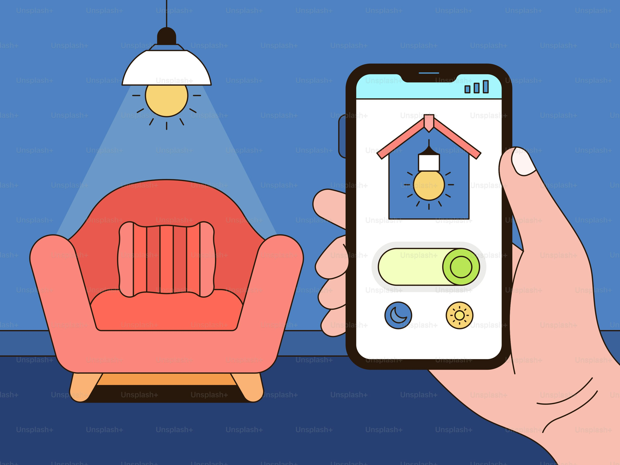
Problem Statement :
Current Issues with Existing Smart Home Automation:
Most systems are expensive and need costly smart devices.
Heavy dependence on voice assistants → unreliable in noisy rooms.
Limited customization — routines don’t adapt to user habits.
Internet-dependent → automations fail in low-network or offline conditions.
No behavior learning → systems cannot predict or automate based on user routines.
Very few support gesture control, and those that do need expensive sensors.
Privacy concerns due to cloud-based data and microphones.
Need:
A low-cost, intelligent, offline-capable smart room system that works without internet dependence and can still perform advanced automation when network is available.

Slide 5
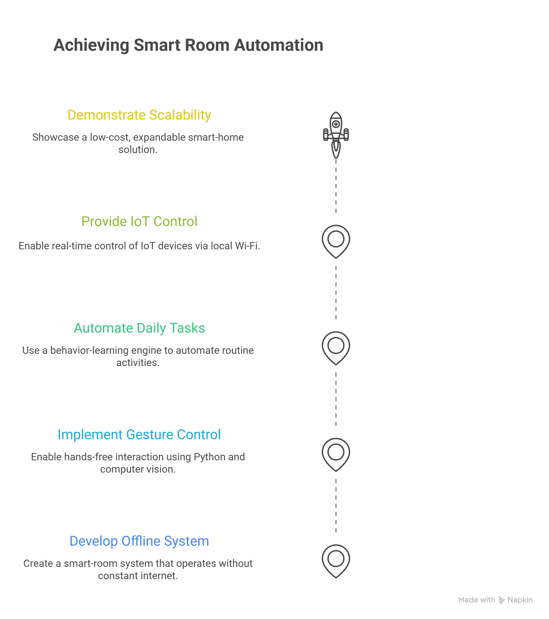
Project Objective:
Main Objectives of Roommate AI:
To develop an intelligent smart-room automation system that works even without constant internet connectivity.
To enable gesture-based control using Python, OpenCV, and Mediapipe for seamless hands-free interaction.
To automate daily tasks through a behavior-learning engine that identifies user habits and triggers actions automatically.
To provide real-time IoT device control through ESP32 and relay modules using local Wi-Fi communication.
To demonstrate a low-cost, scalable, and expandable smart-home solution suitable for rooms, hostels, and small living spaces.

Slide 6
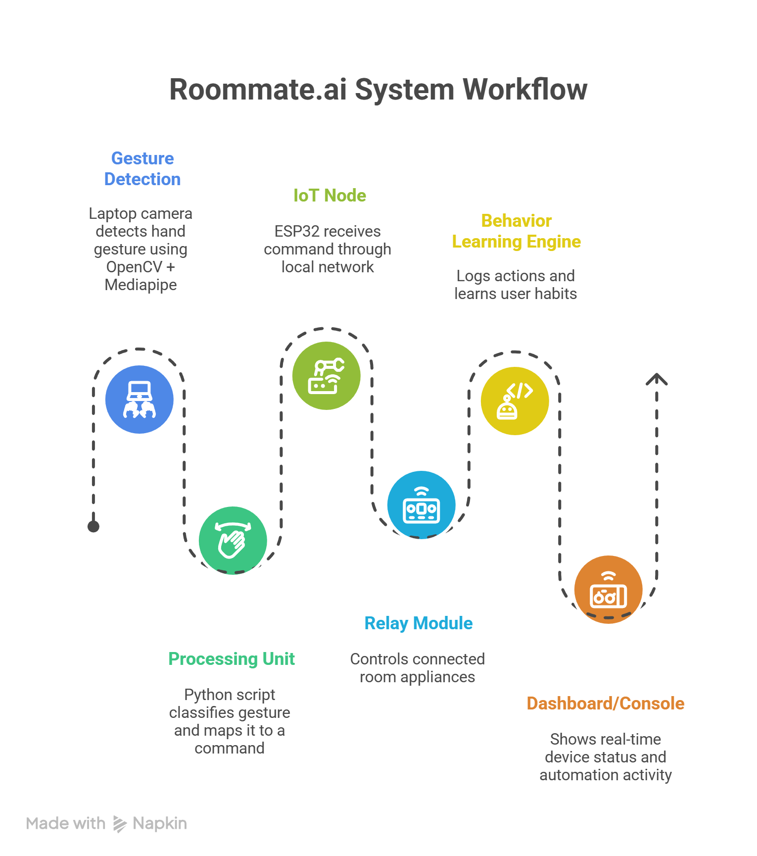
How it works:
How It Works:
Gesture Detection → Laptop camera detects hand gesture using OpenCV + Mediapipe.
Processing Unit (Python Script) → Classifies gesture and maps it to a specific command.
IoT Node (ESP32 + Wi-Fi) → Receives the command through local network.
Relay Module → Controls the connected room appliances (light, fan, etc.).
Behavior Learning Engine → Logs repeated actions and learns user habits for future automation.
Dashboard/Console → Shows real-time device status and automation activity.

Slide 7
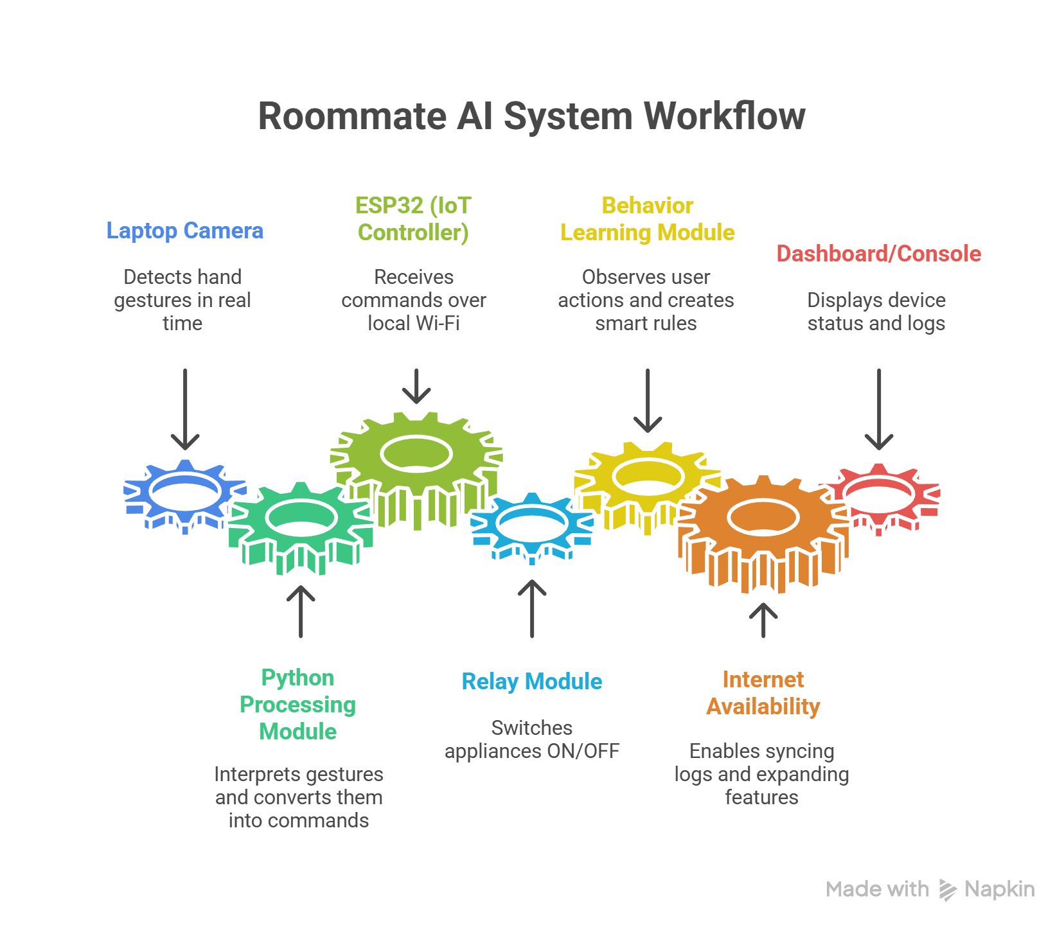
Working of the System:
Working of Our Roommate AI:
Laptop Camera → Detects hand gestures in real time using OpenCV and Mediapipe.
Python Processing Module → Interprets the gesture and converts it into a device command.
ESP32 (IoT Controller) → Receives the command over local Wi-Fi and triggers the connected relay.
Relay Module → Switches room appliances ON/OFF based on received instructions.
Behavior Learning Module → Observes repeated user actions and automatically creates smart rules.
If Internet is Available → System can sync logs, send notifications, or expand automation features.
Dashboard/Console → User can view device status, gesture logs, and enabled automation rules.

Slide 8
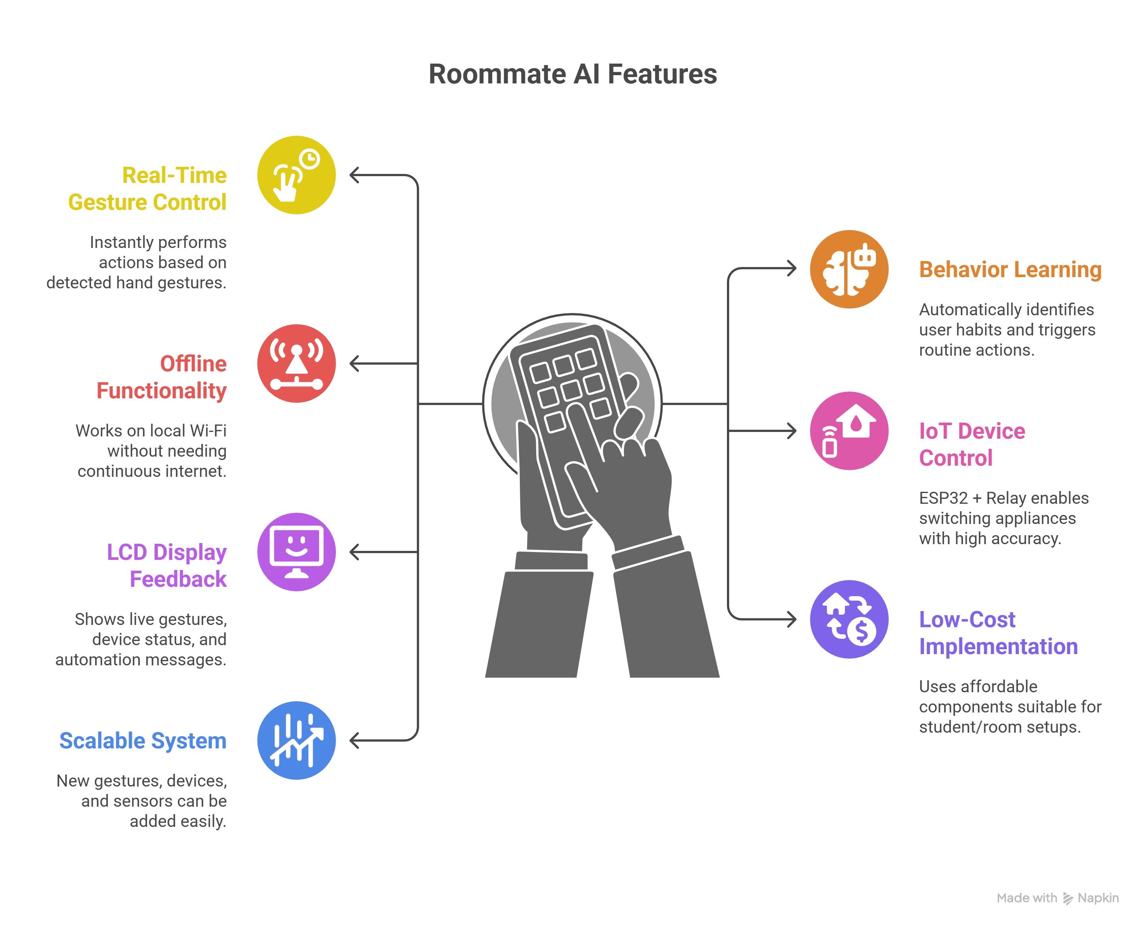
Features of the System :
Key Features of Our Roommate AI :
Real-Time Gesture Control → Instantly performs actions based on detected hand gestures.
Behaviour Learning → Automatically identifies user habits and triggers routine actions.
Offline Functionality → Works on local Wi-Fi without needing continuous internet.
IoT Device Control → ESP32 + Relay enables switching appliances with high accuracy.
LCD Display Feedback → Shows live gestures, device status, and automation messages.
Low-Cost Implementation → Uses affordable components suitable for student/room setups.
Scalable System → New gestures, devices, and sensors can be added easily.

Slide 9
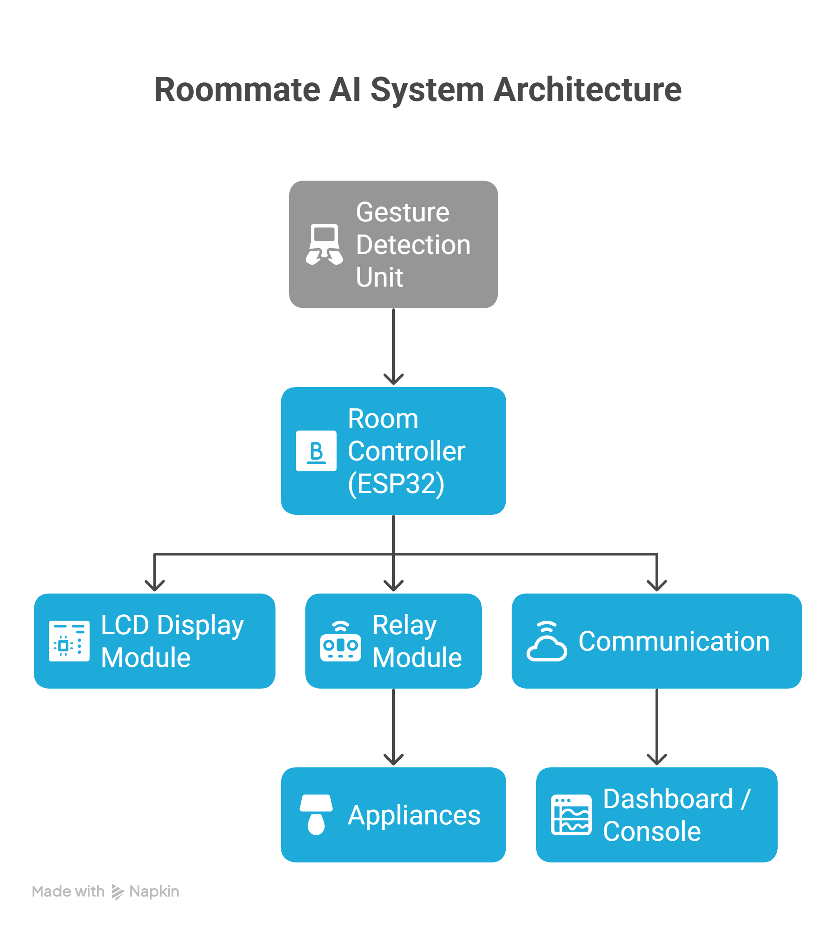
System Architecture:
Gesture Detection Unit: Laptop camera detects gestures using OpenCV + Mediapipe, and Python sends control commands to ESP32.
Room Controller (ESP32): Receives commands over local Wi-Fi, controls appliances via relay, and updates the LCD with system status.
LCD Display Module: Shows live gestures, device states, and automation messages.
Communication: Local Wi-Fi enables fast control; works fully offline, with optional cloud sync when internet is available.
Dashboard / Console: Shows device status, gestures, and automation logs, with manual control options.

Slide 10
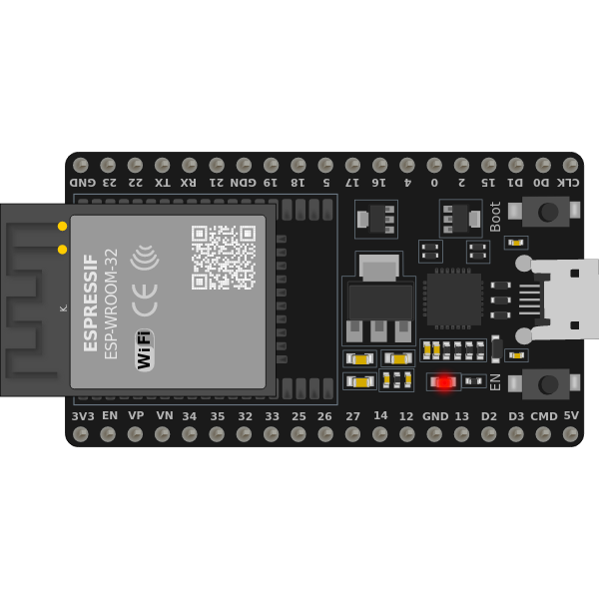
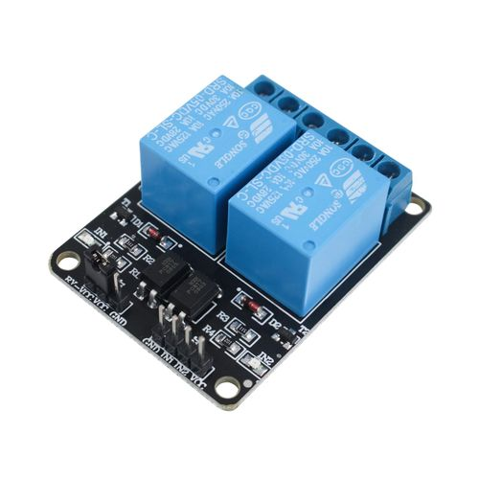
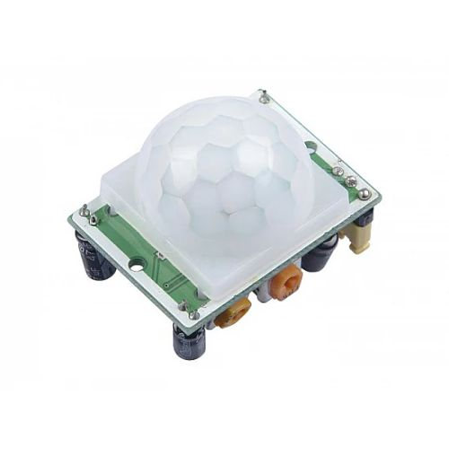
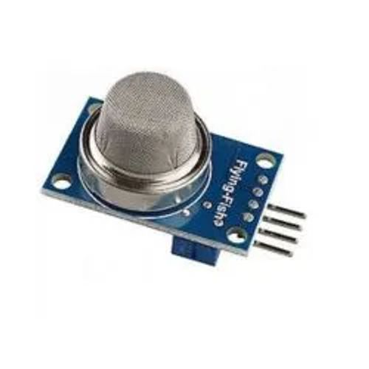
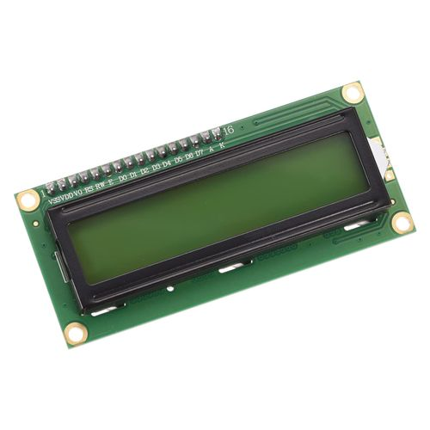
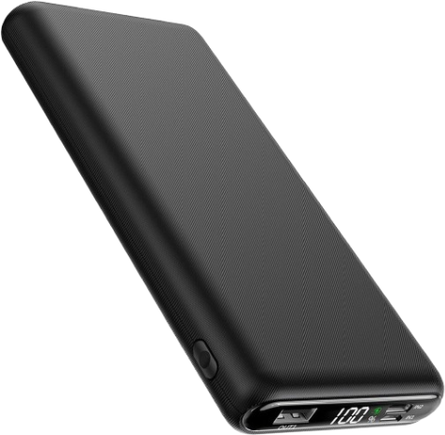
Hardware Components:
ESP32 Development Board:
Microcontroller with Wi-Fi + Bluetooth used to receive commands and control appliances.
Relay Module (5V / 12V):
Allows the ESP32 to switch room appliances like lights, fan, or lamp safely.
Sensors (Motion & Gas):
Motion: Detects movement in the room
Gas: Monitors the presence of harmful gases
Display:
Shows real-time system status like detected gestures, device actions, and automation messages
Power Source (Power Bank):
Power Bank: Provides power to the ESP32 Battery: relay module during operation.

Slide 11
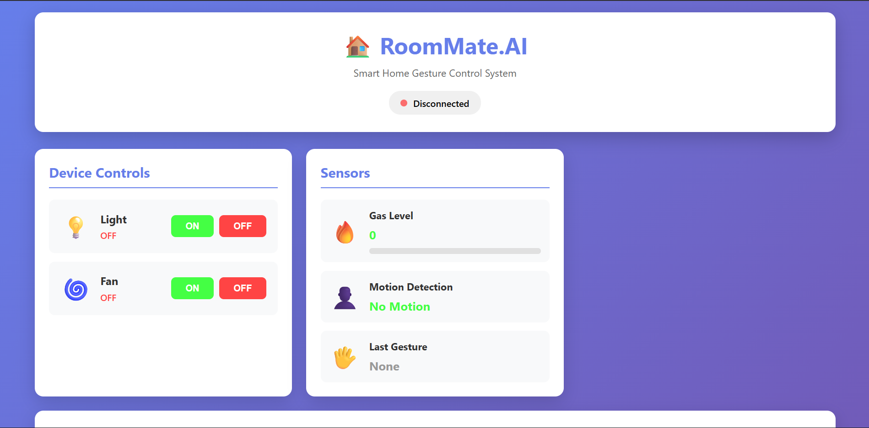
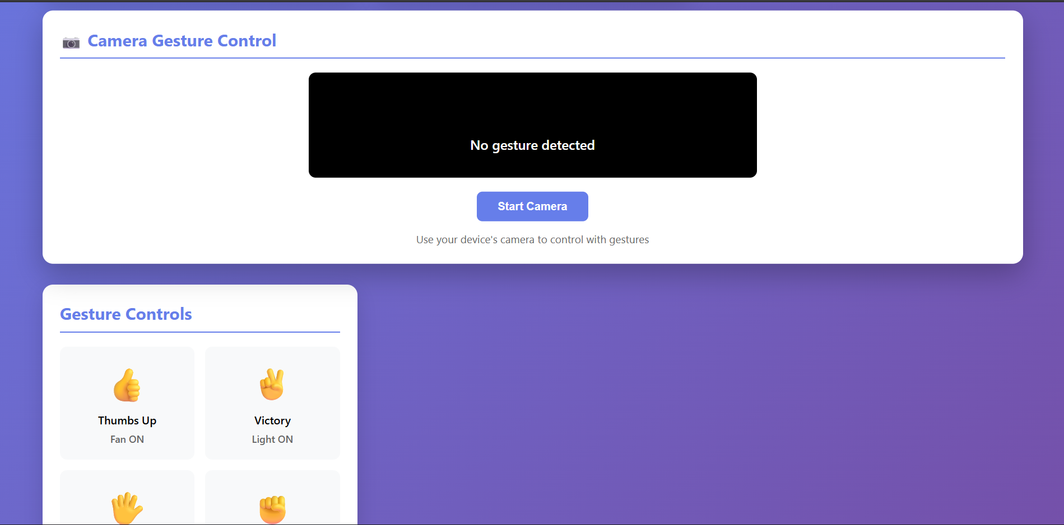
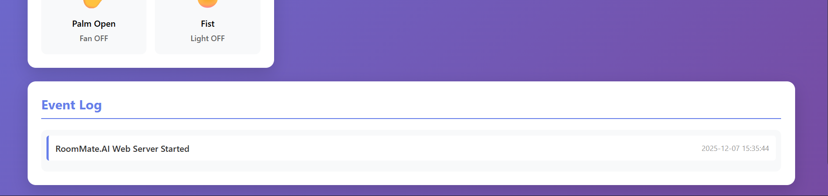
Software Components:
Software Components Used:
Python (OpenCV + Mediapipe): Handles real-time hand gesture detection and command generation.
ESP32 Firmware (Arduino IDE): Controls relays, reads sensors, updates LCD, and manages Wi-Fi communication.
Flask Web Server: Provides a lightweight backend for the web dashboard, API endpoints, and device status handling.
Web Dashboard (HTML/CSS/JS + Flask): Displays real-time device status, gesture logs, and allows manual control.
Behaviour Learning Engine: Tracks user habits and triggers automated routines based on repeated patterns.
Local Wi-Fi Communication: Ensures fast command transfer between Python → Flask → ESP32 without internet dependency.
Website
GitHub

Slide 12
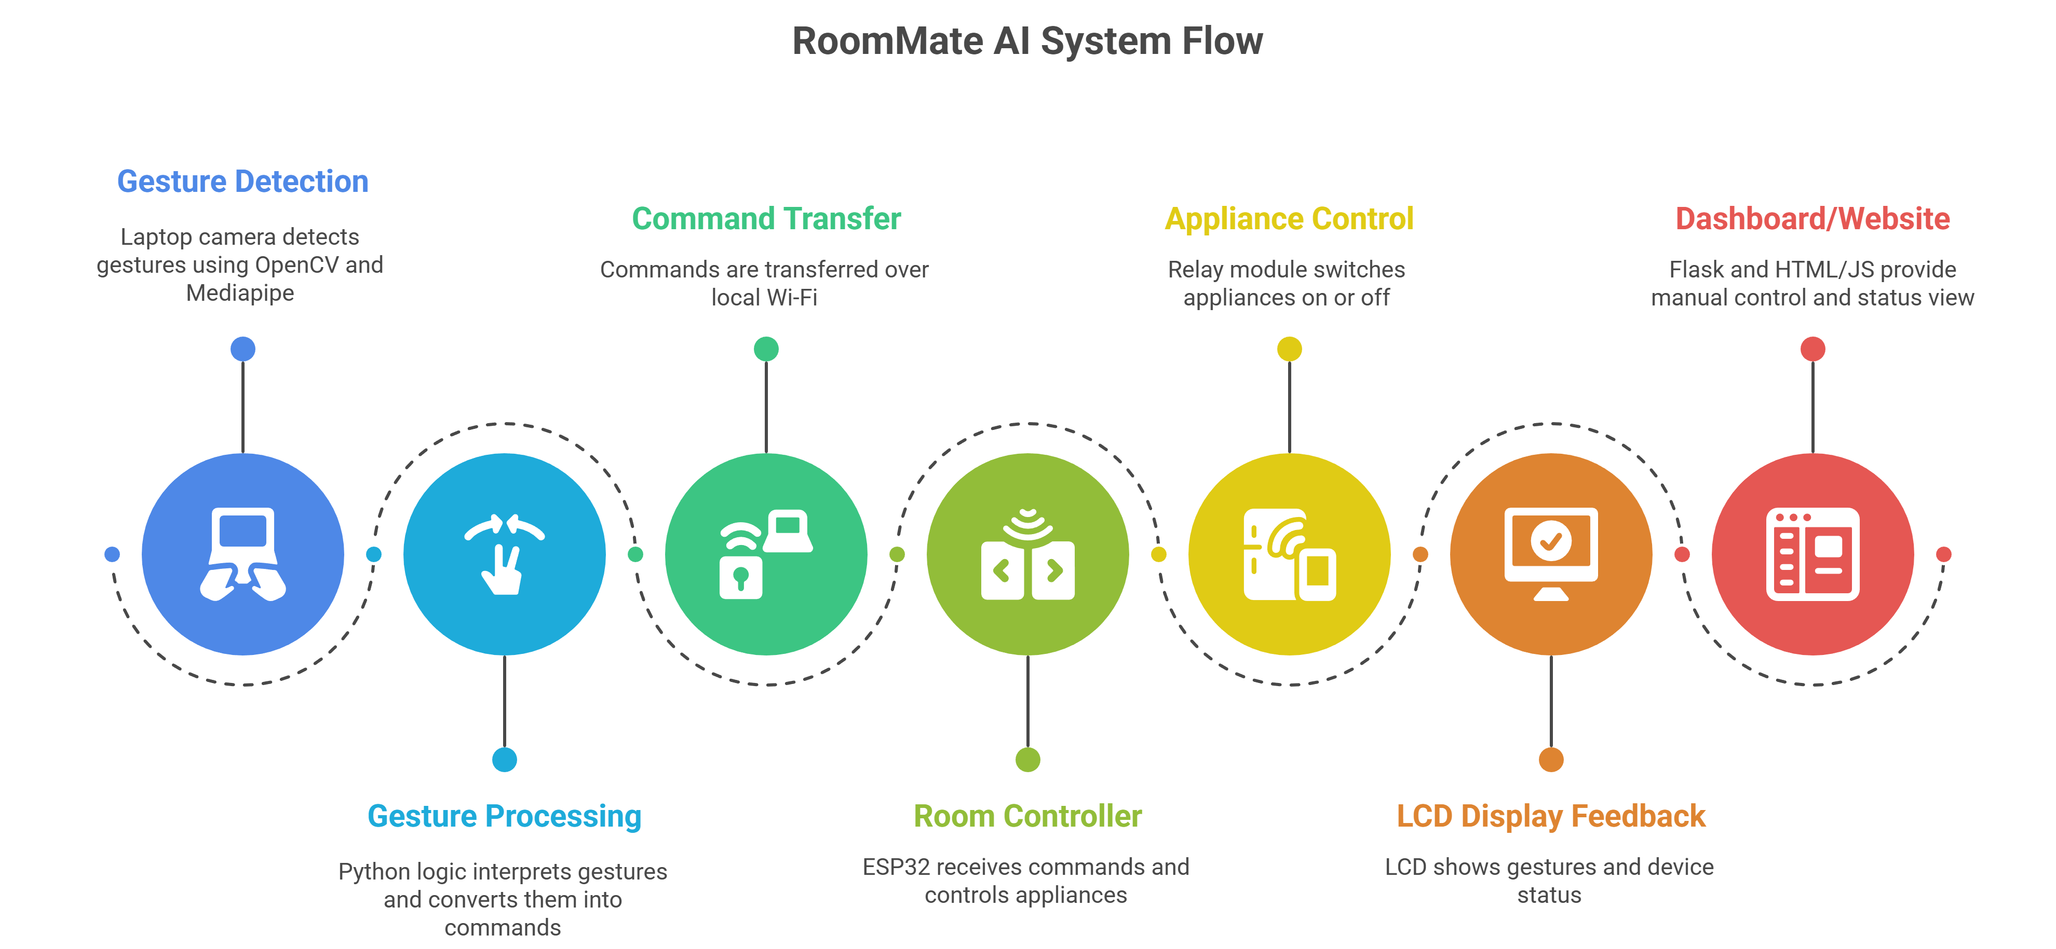
System Flow Diagram:

Slide 13
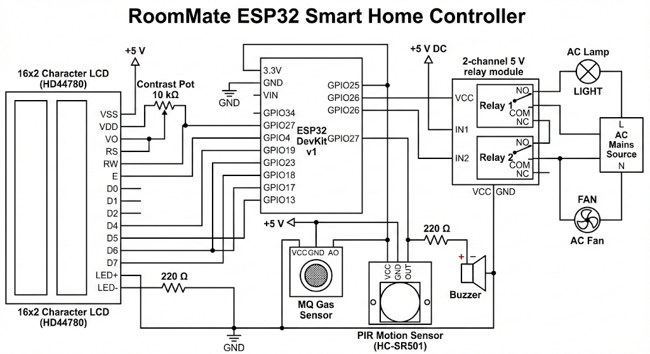
Circuit Diagram:

Slide 14
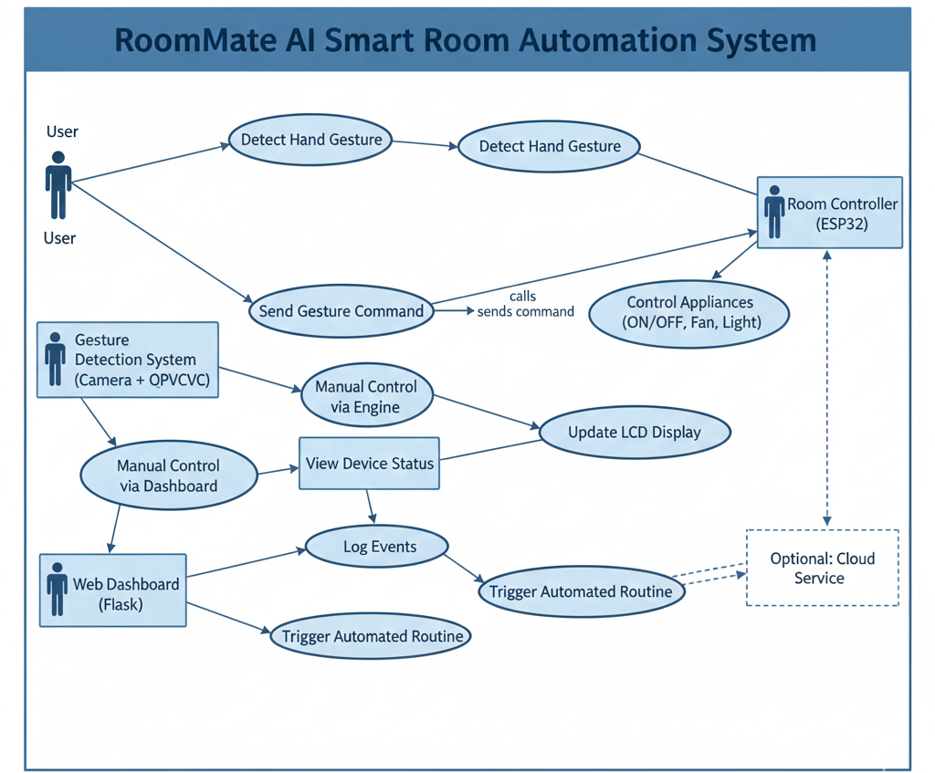
UML use case diagram:

Slide 15


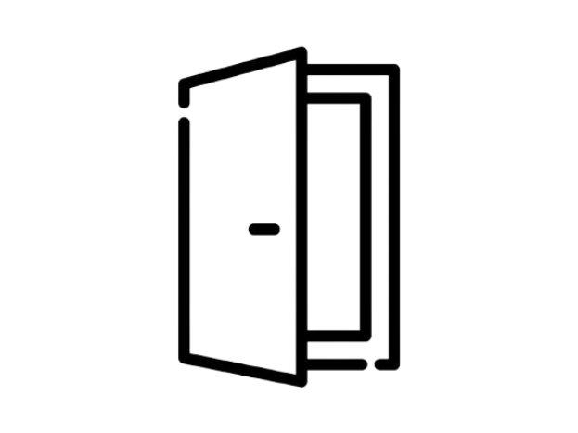
We Are Open For Questions

